Slide 1
SAFETY AT WORKPLACE
-NITHAN.R
DHARANEESH
GOKUL KRISHNA
MOHANASHARAN
( AI & DS )

Slide 2
Abstract:
Workplace safety refers to the working environment at a company and encompasses all factors that impact the safety, health, and well-being of employees. This can include environmental hazards, unsafe working conditions or processes, drug and alcohol abuse, and workplace violence. Workplace safety is monitored at the national level by the Occupational Safety and Health Administration (OSHA). OSHA has three stated goals that serve as the cornerstones of its policies and regulations: 1) Improve the safety and health for all workers, as evidenced by fewer hazards, reduced exposures, and fewer injuries, illnesses, and fatalities; 2) Change workplace culture to increase employer and worker awareness of, commitment to, and involvement in safety and health; 3) Secure public confidence through excellence in the development and delivery of OSHA's programs and services. The federal guidelines imposed by this agency are complemented by state regulations that are often tougher than those proposed by OSHA.

Slide 3
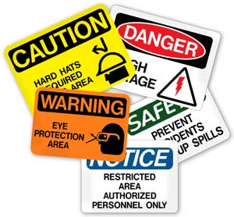
Overview:
Abstract
Workplace Safety Define
A national survey
The Importance of Keeping Your Workplace Safe
Employee retention
Employee productivity
Company reputation and Employer Branding
8 Workplace Safety Best Practices
10 Common Workplace Safety Tips for Employees
10 Workplace Safety Threats by OSHA
CONCLUSION
This Photo by Unknown Author is licensed under CC BY-ND

Slide 4

Workplace Safety Defined
Safety of workers (also known as worker safety and occupational health and safety) refers to the provision of a safe working environment, safe equipment, policies, and procedures in order to ensure workers' health and safety.
In 2020, workplace safety has become one of the main concerns for many employers. Not only the COVID-19 pandemic is resulting in more illnesses, but the emergence of remote work and dispersed workplaces are making it harder for employers to reach their frontline and deskless employees.
This Photo by Unknown Author is licensed under CC BY

Slide 5

A national survey
A national survey by The Hartford Financial Services Group found that 58% of blue-collar households have “a family member who has been injured on the job, requiring medical attention.”
While organizations have a moral obligation to ensure safe working conditions, unsafe workplaces can also have serious legal and financial consequences for employers.
This Photo by Unknown Author is licensed under CC BY-NC-ND

Slide 6

The Importance of Keeping Your Workplace Safe
Safety in the workplace has a significant impact on many business KPIs. In other words, safer working environments benefit from fewer accidents, which results in fewer occupational health costs, better employee retention and satisfaction, less employee downtime, and less retraining time.
This Photo by Unknown Author is licensed under CC BY-SA-NC

Slide 7

Employee retention
Employees appreciate safe working environments, which is a sign that their employer cares about their wellbeing. Therefore, employees who feel safe at work are also more loyal to their employers and stay longer within their organizations.
On the other hand, those who don’t feel safe or have experienced workplace accidents are much more likely to search for new employers.
This Photo by Unknown Author is licensed under CC BY-SA-NC

Slide 8

Employee productivity
Employees who feel safe in their working environments are also more productive than those who have been injured in the past and, therefore, have developed a certain level of anxiety and fright.
Eliminating workplace hazards enables employees to stay invested in their work and do their best.
This Photo by Unknown Author is licensed under CC BY-NC-ND

Slide 9
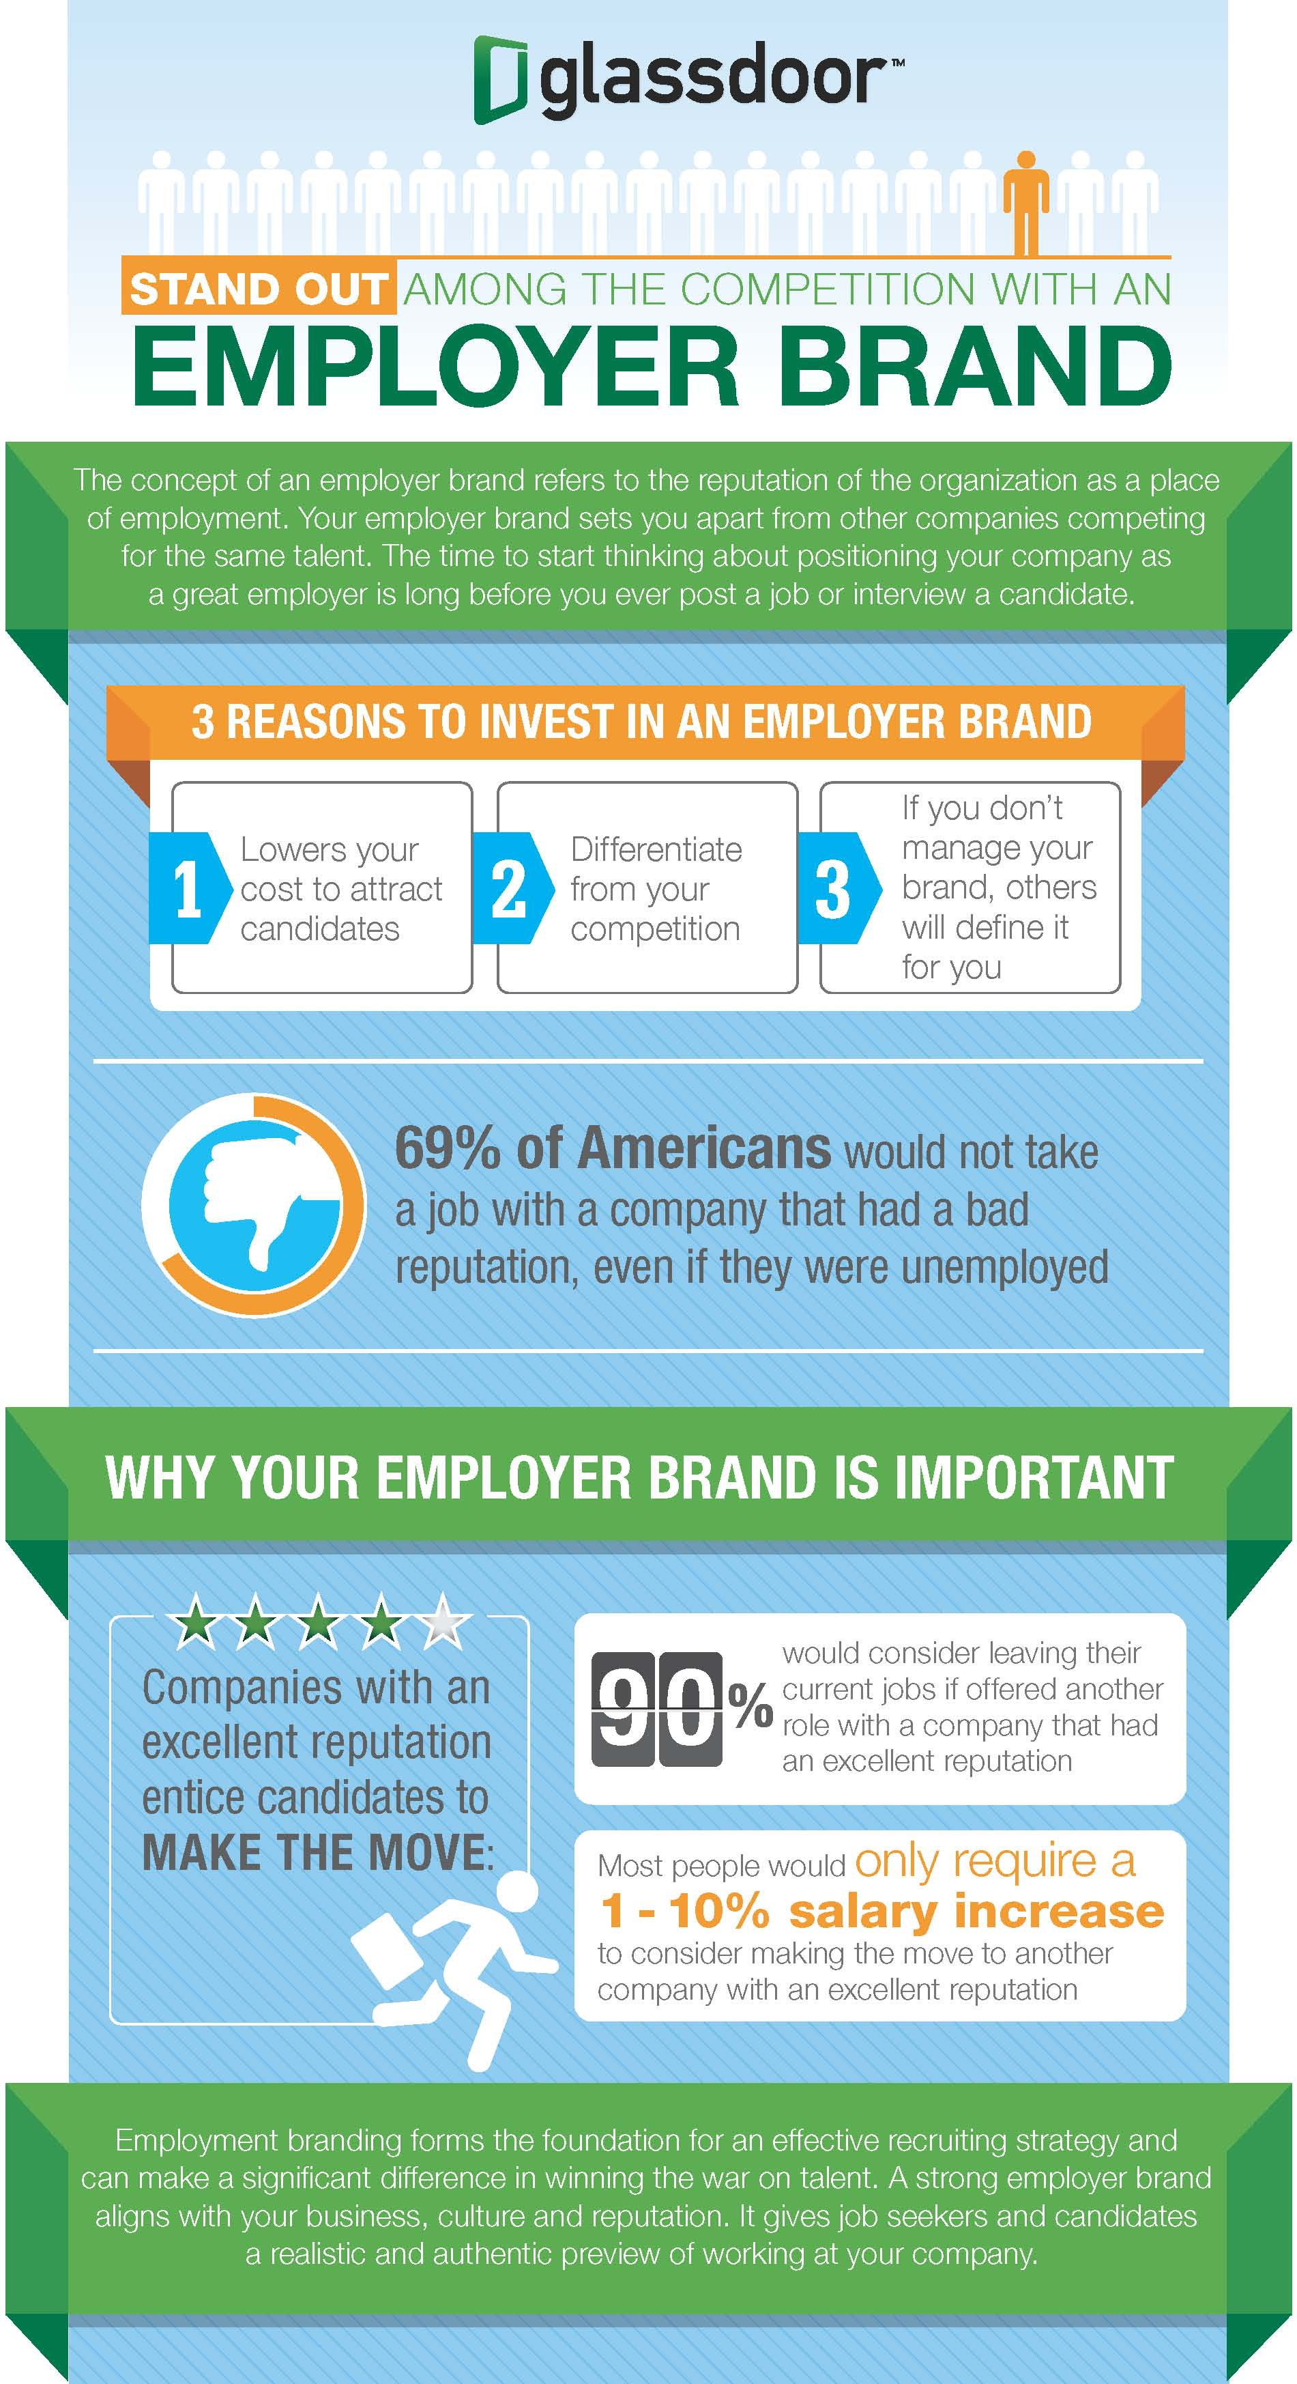
Company reputation and Employer Branding
Companies that don’t invest in workplace safety quickly develop a reputation of an unsafe employer, which has a big impact on employer branding and talent attraction efforts. Moreover, the company's customers, competitors and the general public often perceive such companies as unprofessional.
As a consequence, fewer employees apply for jobs, and the most skilled workers often search for jobs elsewhere.
This Photo by Unknown Author is licensed under CC BY-NC-ND

Slide 10

8 Workplace Safety Best Practices
Organizations with employees who are at high risk of getting injured often have structured and well-designed workplace safety strategies in place. As they are aware of the consequences of neglecting workplace safety, they understand that having a good plan can significantly improve employees’ health, safety and wellbeing.
Let’s now take a look into some best practices for ensuring safe working conditions.
This Photo by Unknown Author is licensed under CC BY-NC

Slide 11
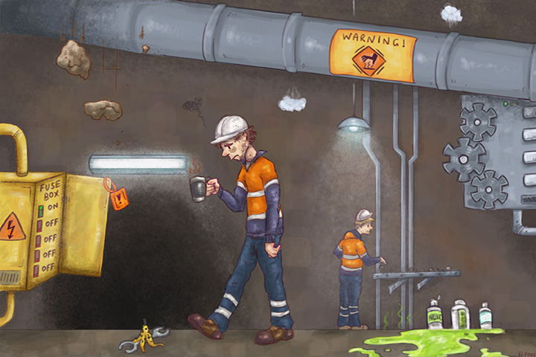
1. Identify all the workplace safety hazards
Before you even start building your workplace safety plan, it is important to define and understand all the potential sources of hazard in the workplace.
Identifying those safety hazards and issues is the first step in protecting employees in the workplace. Some of the most common hazards often include ergonomics, hazardous chemicals, mechanical problems, noise pollution, restricted visibility, dangers of falling and weather-related hazards.
This Photo by Unknown Author is licensed under CC BY

Slide 12

2. Define safety policies and remind employees to follow them
After identifying all the possible workplace hazards, the next step is to define safety policies and procedures. Many organizations have safety handbooks that employees can use as a reference every time when in doubt.
However, creating such materials is not enough if your employees don’t consume and follow them. It is the employers’ job to continuously remind employees of the importance of following safety guidelines. Moreover, under OSHA regulations, employees are required to comply with the standards, rules, and regulations put in place by the employer.
This Photo by Unknown Author is licensed under CC BY

Slide 13

3. Involve leadership and encourage employees' share of voice
Creating safe workplace environments starts at the top. Without the leadership’s buy-in, it is impossible to amplify the safety messages and encourage employees to follow them.
Senior leadership must set the communication standard by providing an open and transparent environment. Such environments facilitate and drive discussions that allow employees to offer suggestions, report concerns and feel empowered to contribute to the workplace safety programs.
This Photo by Unknown Author is licensed under CC BY-NC

Slide 14

4. Designate a health and safety representative
As some employees are reluctant to share their safety issues with their direct managers, some organizations appoint designated health and safety representatives.
By doing so, employees can confidently and discreetly discuss their concerns with the representatives who act as a trusted intermediary between managers and employees.
However, employers are responsible for enabling these representatives to always be connected with employees , and making sure that they can reach out to them in a timely manner. Yet, many companies still don’t have access to the right technology that enables them to do so.
This Photo by Unknown Author is licensed under CC BY-SA

Slide 15
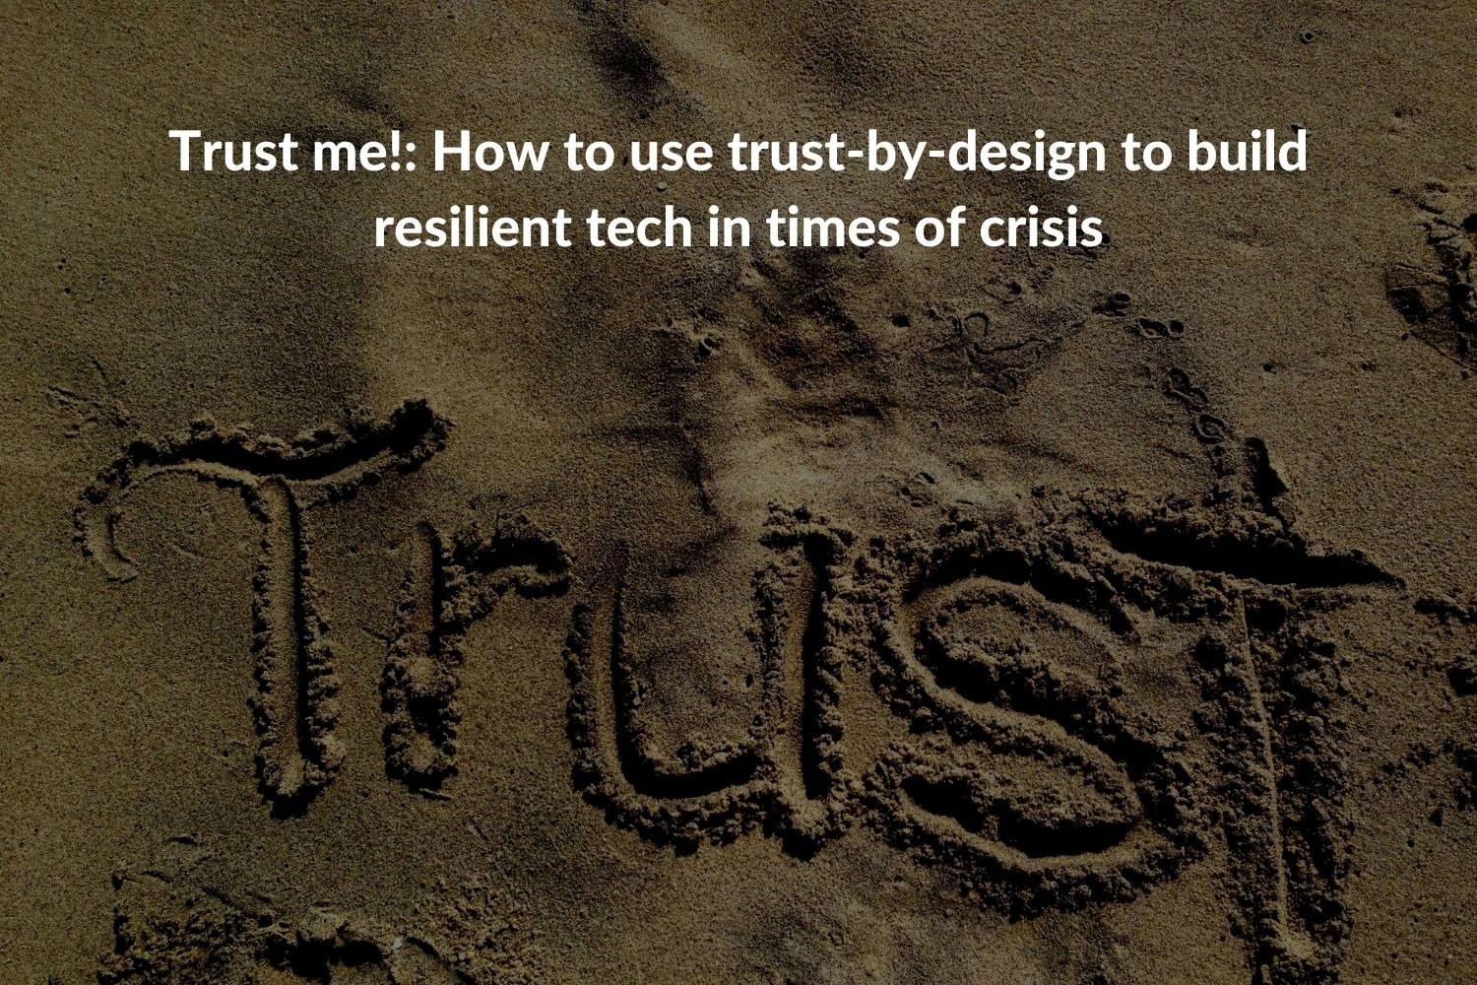
5. Build trust and be consistent
Fostering a safety-centric workplace environment begins by building trust in the workplace . Workers must be able to trust that their leaders’ number one priority is keeping their employees safe and that they can report to them if they notice any unsafe activity.
However, this type of employee behavior doesn’t happen over time, and a successful transition to an employee – centric workplace culture takes time to build. Honest, consistent and transparent workplace communication, as well as constant check-ins with employees, are the key.
This Photo by Unknown Author is licensed under CC BY

Slide 16

6. Enable easy access to important documents and information
Blue-collar workers are often the ones with the highest risk of getting injured at work. These employees spend most of their time outside of the company's offices, and they often don’t have designated working spaces.
These, hard to reach employees, need to have instant access to all important safety materials and documentation available on their mobile phones. On the other hand, employers need to eliminate information overload .
Moreover, these employees should have access to personalized employee news feeds where they can consume content relevant to their job roles and potential hazards specific to their functions.
On the other hand, managers and safety representatives need to have a way to send instant updates, safety push notifications and the ability to automatically share content from credible safety sources such as OSHA.
This Photo by Unknown Author is licensed under CC BY-SA

Slide 17

7. Help managers and employees to always stay connected
It is important that you enable supervisors to keep employees informed about potential hazards or risks in the workplace. Managers should have the ability to create designated safety communication channels where they can share important information and communicate with their teams.
Similarly, when employees notice a potential hazard in the workplace, they should be able to instantly reach their fellow coworkers to inform and alarm them about the hazard.

Slide 18

8. Recognize those who follow the rules and regulations
In addition to keeping employees informed, it is important to praise and recognize those who regularly do their jobs safely. This builds a more open, positive safety culture and increases the likelihood that others will embed the same behaviors.
This culture of appreciation goes a long way when you want others to understand and support your plan. Share your employees successes and amplify positive examples, give public recognition and enable others in your organization to join the conversations.

Slide 19

10 Common Workplace Safety Tips for Employees
Be aware of your legal responsibilities.
Stay committed to health and safety at work.
Get familiar with all the potential hazardous situations in the workplace.
Often review the latest safety policies and procedures.
Stay informed with the company’s safety updates.
Identify, assess and manage hazards within the workplace.
Inform, train and supervise your employees on safety practices.
Ensure that incidents and injuries are reported, recorded and investigated.
Share your concerns and feedback and suggest solutions for improvement.
Ensure that you are planned and prepared for emergencies.
This Photo by Unknown Author is licensed under CC BY

Slide 20

10 Workplace Safety Threats by OSHA
According to OSHA, the top 10 areas for which citations are issued include:
Forklifts
Hazard communication
Electrical wiring methods
Electrical system design
Guarding openings
Exits
Mechanical power transmission
Respiratory protection
Lockout/tagout
Portable fire extinguishers
This Photo by Unknown Author is licensed under CC BY-SA-NC

Slide 21

CONCLUSION
A safe and healthy workplace not only protects workers from injury and illness, it can also lower injury/illness costs, reduce absenteeism and turnover, increase productivity and quality, and raise employee morale. In other words, safety is good for business.
This Photo by Unknown Author is licensed under CC BY-SA

Slide 22

This Photo by Unknown Author is licensed under CC BY-SA

